Slide 1
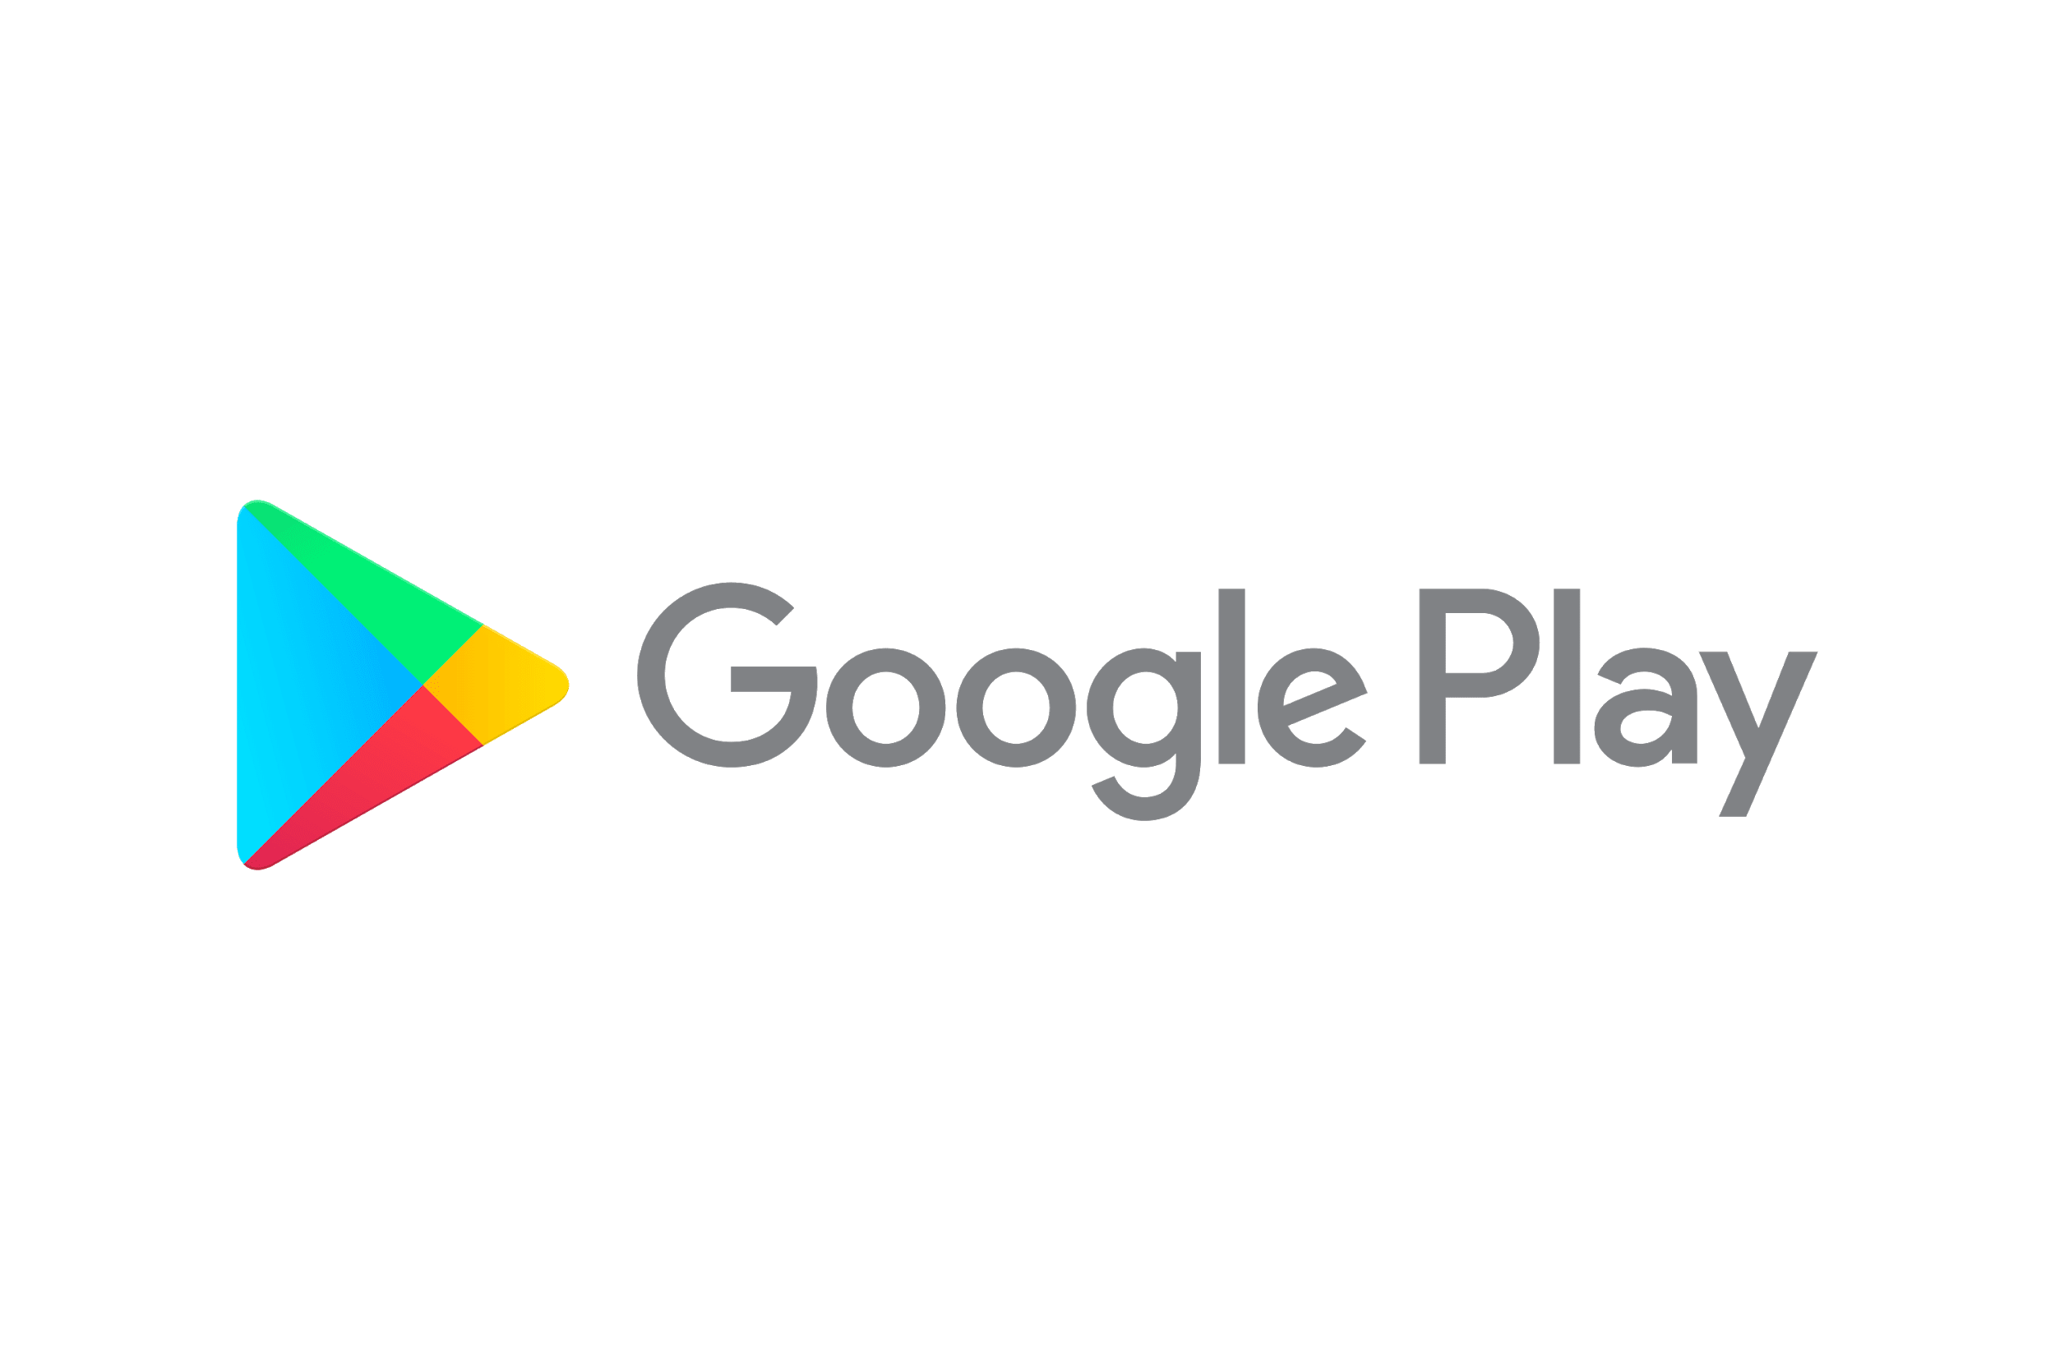

Slide 2
ANALYSIS OF GOOGLE PLAY STORE
(DATA SCIENCE-3151608)
PRESENTED BY:-(SEM5)
1)SUTHAR NEEL J(180170116046)
2)PATEL JAY A(180170116029)

Slide 3
INDEX:-
1.AIM
2.INTRODUCTION
3.DATASET
4.BACKGROUND
5.IMPLEMENTATION
6.CONCLUSION

Slide 4
AIM:-
The Internet is a true gold mine of data. E-commerce and review sites are brimming with a lot of untapped data with a prominent potential to convert into meaningful insights that can help with robust decision making. Here, we explore using data science and machine learning techniques on data retrieved from one such avenue on the internet, the Google Play Store.This project aims to employ machine learning & visual analytics concepts to gain insights into how applications become successful and achieve high user ratings.

Slide 5
WHAT IS GOOGLE PLAY STORE?
Google Play, formerly Android Market, is a digital distribution service operated and developed by Google. It serves as the official app store for certified devices running on the Android operating system, allowing users to browse and download applications developed with the Android software development kit (SDK) and published through Google. Google Play also serves as a digital media store, offering music, books, movies, and television programs.

Slide 6
WHAT IS GOOGLE PLAY STORE?
Applications are available through Google Play either free of charge or at a cost. They can be downloaded directly on an Android device through the proprietary Play Store mobile app or by deploying the application to a device from the Google Play website. The Google Play store had over 82 billion app downloads in 2016 and has reached over 3.5 million apps published in 2017.

Slide 7
DETAIL OF DATASET:-
The Play Store apps data has enormous potential to drive app-making businesses to success. Actionable insights can be drawn for developers to work on and capture the Android market. The dataset is chosen from Kaggle. It is the web data of around 10k Play Store apps for analyzing the Android market. It consists of in total of 9360 rows and 13 columns.

Slide 8
BACKGROUND:-
As mobile apps have become so prevalent, and more and more developers make their livelihood off of mobile development alone. It has become important for developers to be able to predict the success of their app. Our goal was to find the overall rating of an app because so much of the users’ trust in the app comes from that one statistic alone. Higher rated apps are more likely to be recommended and more likely to be trusted by users that find the app while browsing the app store.

Slide 9
DATA FILTERING
DATA VISUALIZATION
DATA PREPROCESSING
PREDICTION

Slide 10
CONCLUSION:-
For this project, we took the Google Play Store Data sets and analyzed and processed the data. After the data was transformed into a usable set, we used plots and functions to understand the correlations between features. We then used this knowledge to build the best model we could for finding ratings based on the cleaned data set.
Exploratory data analysis of the Google play store data was done.
Top Apps that are most downloaded is found out.
Thus, we can find rating of app using random forest regression.

Slide 11
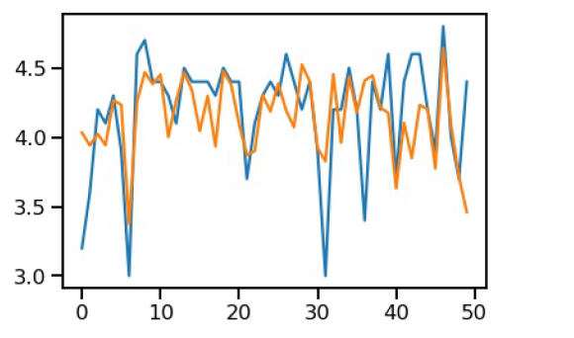
ACTUAL VS. PREDICTED GRAPH OF RATING:-

Slide 12
THANK YOU!!

